Slide 1


ECEN 404 Final Presentation Team 55: Research Lab Inventory Tracker Lizzett Tapia
Sumedha Bhattacharyaa
Jonathan Moore
Evan Ross TA: Niloofar Borzooei

Slide 2

Problem Statement
“The current lab inventory tracking systems at Texas A&M are inefficient, and it is necessary to create new, organized software to increase the overall performance and efficiency of the Lab.”

Slide 3

Solution Proposal
“Develop a web and mobile application integrated with a database to streamline inventory management in TAMU labs. The mobile app uses a machine learning-based image classification system to allow users to easily check items in and out by scanning them.”

Slide 4
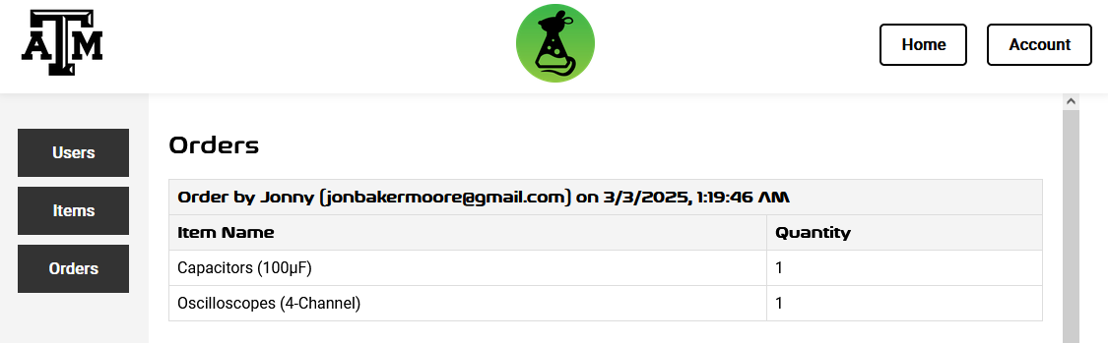
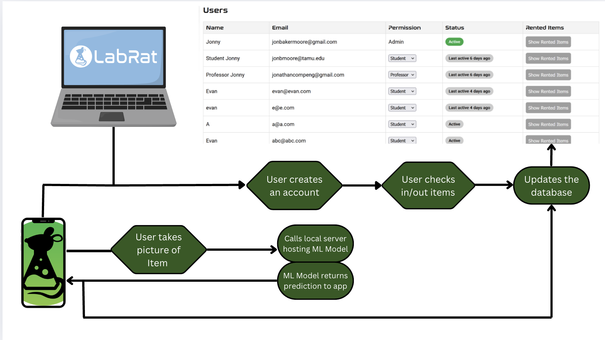
Integrated System Diagram
Notes:
Eric

Slide 5
Mobile App Design and Implementation
Software and Methodology:
The Mobile app was developed using Android Studio with the Flutter Plugin
Uses the Dart development language
Designed specifically for android phones
Uses various plugins for fonts, temporary local database, password encryption ect.
Functionality
Works largely in the same way as the website with some minor differences as there is a different use case.
Allows users to check in and check out items “on the go” in a Laboratory
Uses the camera along with the ML model to allow users to scan specific items
Information regarding users and items is stored in the external database

Slide 6
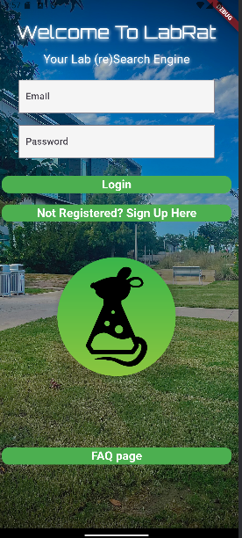
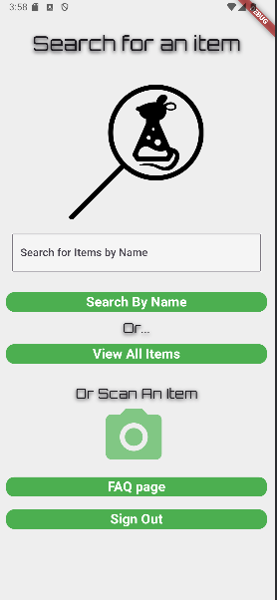
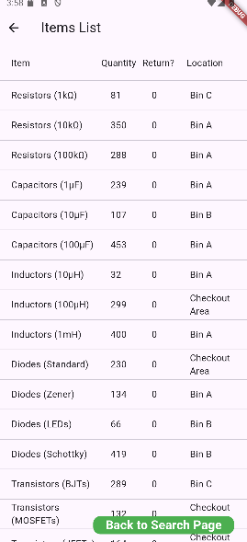
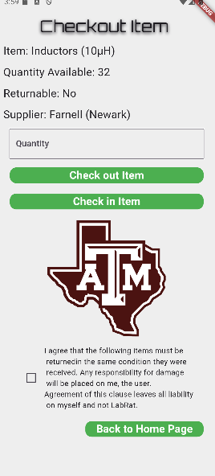
Mobile App
Functionality and
Challenges
Challenges and Solutions:
There were many minor challenges regarding code implementation, but were easily fixed through some research and experimentation
Notable challenges regarding the linking of subsystems are below
Unable to link app to machine learning model directly | Created a flask backend to help relay requests to the ML model and allow it to function with the app
Was unable to link with database initially | Had to change permissions in the database to allow access

Slide 7
Mobile App Validation
Most of the functionality testing was done through the user interface of the app on a physical device.
The testing mainly consisted of using the app as intended while also testing any edge cases that might cause the app to not work as expected. When testing the app it essentially worked 100% of the time since it is more software based. Any bugs and edge cases that caused issues in testing are fixed.
Requirement | Target Spec | Test Results
ML model load time | < 5 sec | < 3 sec (2.3 sec average)
App Start Time | < 10 sec | < 5 sec (varies depending on hardware)

Slide 8
ML Model Design and Implementation
Design & Integration
Designed a Machine Learning image-classification model to identify items scanned through the mobile app
Designed a local Flask server to host the model
Integrated the Machine Learning Model with the Mobile App
Challenges & Solutions
Issues in connecting with AWS Server | Created local Flask server instead
Inaccurate classification from limited training data | Augmented data through cropping, rotation, etc.

Slide 9
ML Model Testing & Validation
Requirement | Target Spec | Test Results
Proper classification of scanned items | > 85% accuracy on test data | Model Accuracy on Test Set: 89%
Model Response to App Input | Return prediction in < 4 s | Average Response time: 2.3 s
System stays live through model retraining | No interruption during updates | Retrained and updated model live: Pass
Validation Tools:
Flask for hosting server and storing images to debug
Sklearn for logging accuracy

Slide 10
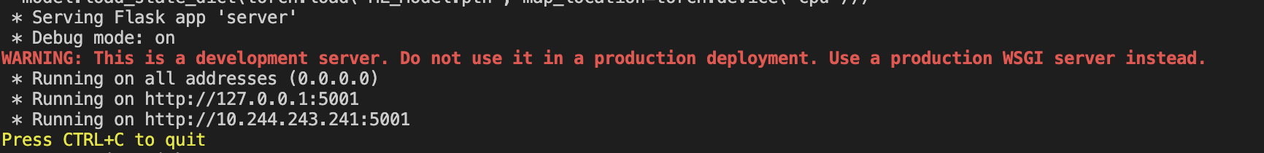
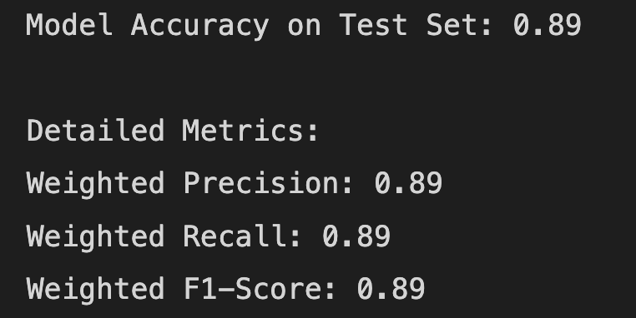
Machine Learning Model
Notes:
1st screenshot shows local Flask server running
2nd screenshot shows important Model Metrics

Slide 11
Database Server Design & Implementation
Design & Integration
Designed and implemented a MySQL database on AWS RDS to support real-time inventory tracking for a research lab
Developed schema with core data tables:
users, items, category, cart, orders, returns
Ensured secure, remote access for website and mobile subsystems
Challenges & Solutions
Data redundancy due to unnormalized structure | Revised schema MySQL connection
Unable to establish proper connection with ML model and mobile app | ML model needed its own server Had to alter database permission access

Slide 12
Database Server Testing & Validation
Requirement | Target Spec | Test Results
Remote database connectivity | 100% successful connections | 100% success from website & mobile app
Data accuracy on insert/update/delete | 0% corruption or inconsistency | All operations performed with 100% data integrity
Automated backup availability | Snapshots for 7-day recovery window | Verified weekly through AWS database instance
Query response time | < 500 ms average response | Min: 46ms, Max: 63ms
Validation Tools:
MySQL Workbench for live testing
Custom test scripts to simulate insert/query operations
AWS Console for backup verification

Slide 13
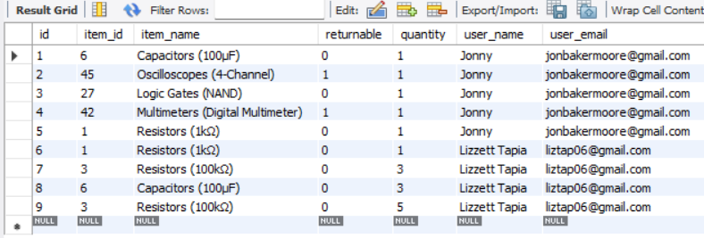
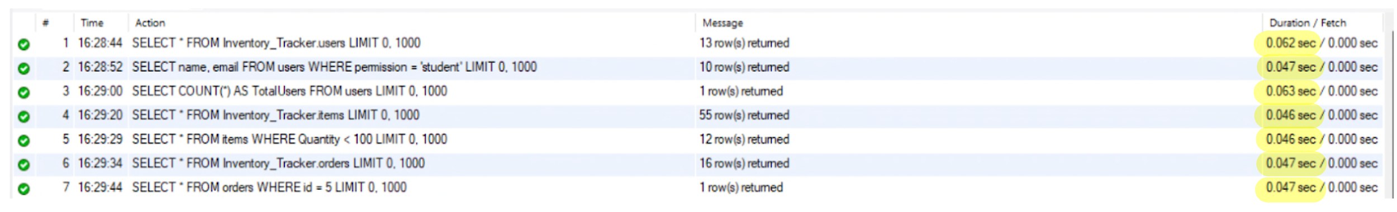
Database Server
Notes:
1st screenshot: ex of an orders table, which allows every type of info to be visible, such as item name, the user who placed order + email, quantity, etc
2nd screenshot: shows different query response times

Slide 14
Website Design and Implementation
Design & Integration
Express.js server using RESTful API endpoints to manage all functionality associated with managing the database.
Designed user interface to intuitively guide users through usage while staying responsive and stylish.
Integrated with the database with room for increased scalability
Challenges & Solutions
Data integrity (e.g. two checkouts on same item simultaneously) | Blocking using atomic SQL transactions so only one checkout per item at a time
Authentication not possible through Google OAuth | Creating own authentication using bcrypt and prepared SQL queries to prevent injection

Slide 15
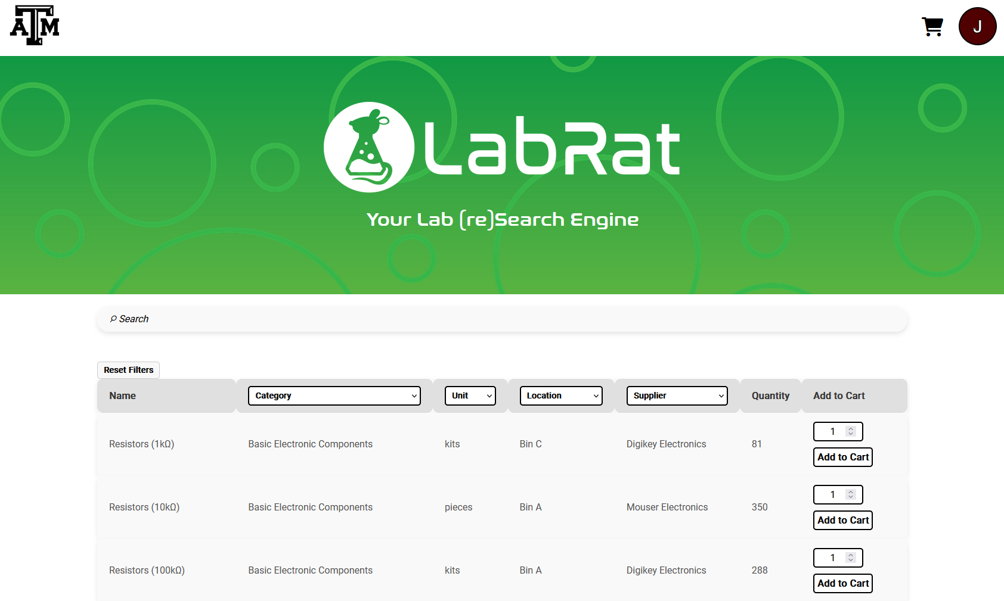
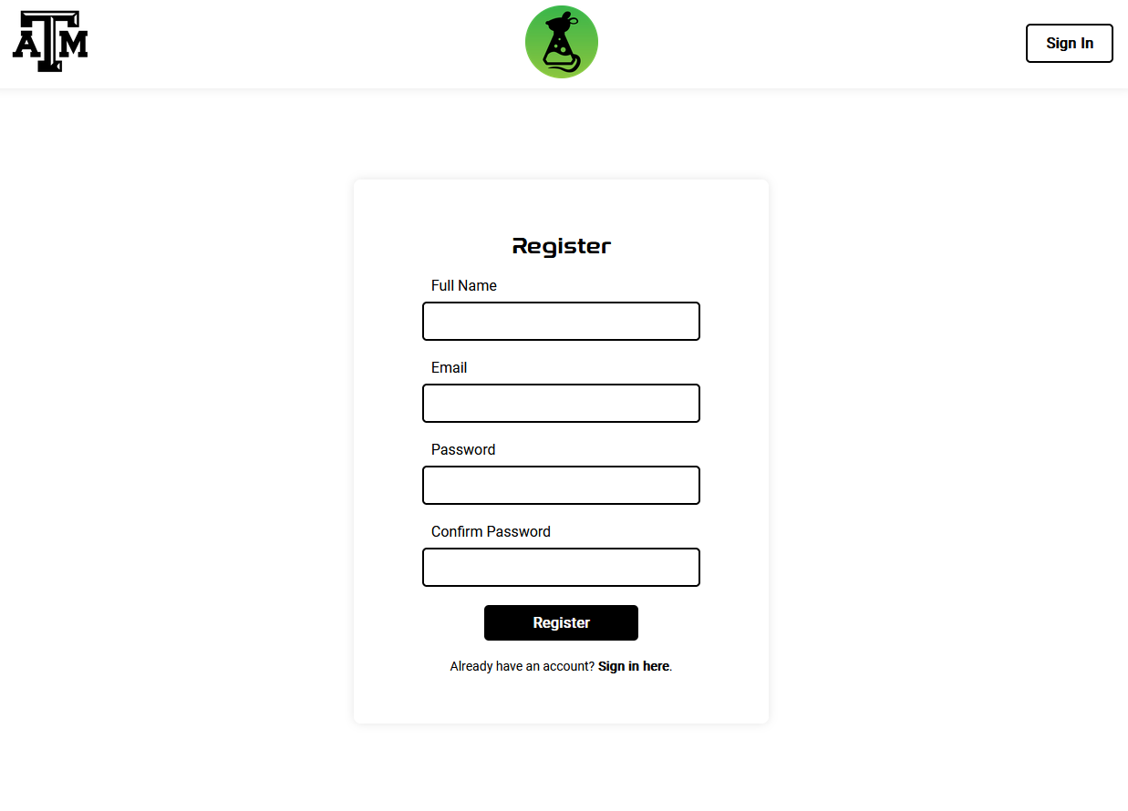
Website User Interface

Slide 16
Website Testing & Validation
Requirement | Target Spec | Test Results
UI Consistency across browsers | 100% successful regression testing | 100% success
Website security testing | No possible HTTP requests, cookie modifications, etc. | All confirmed by hosting website through Render
Data Integrity when on heavy load | Maintain all functionality and retention when busy | Website was consistent across Firefox’s speeds
DB API response time | < 500 ms average response | Avg: 73ms, Peak: 124ms
Validation Tools:
Postman API testing
Playwright UI tests
MySQL Workbench for DB connection
Firefox for data transfer rate throttling

Slide 17
Integrated System Results for Website
Viewing and Editing Inventory via Website
Professors and Administrators can manage items and observe orders and users.
Students and faculty can create larger orders than possible on the mobile application.
All users can edit their personal information from the website.
Performance Results:
Metric | Target | Result
Query response time | ≤ 200 ms | Avg: 32 ms
Edit/Update operation success rate | Perfect | Apart from user error, perfect
User Interface update propagation delay | ≤ 2 seconds | Avg: 0.9 s

Slide 18
Integrated System Results for Mobile App
Checking Items Back In via Mobile App
User logs in through the app and clicks on “scan Item” Icon
User uses device camera to scan item
ML model classifies the item
App fetches item info from the database and updates item inventory
The update is immediately visible on all ends
Performance Results:
Metric | Target | Result
Item Classification Accuracy | >85% | 89%
Fetch Database Info | < 1 sec | 0.5 sec
ML model connection rate | 100% | 100%
DB update success rate | 100% | 100%

Slide 19
Conclusions
Current Status:
Integration completed, Validation still requires 5/20 tests to be completed.
Error Handling and User Feedback, App security from SQL injection, Version Control Consistency, Storage of data over time, Validation of Notifications.
Design Changes:
ML Model hosted on local Flask server, instead of main AWS server.
Website backend changes for MySQL.

Slide 20
Thank You For Listening!

